Slide 1

IceCream Shop Website
Web Application Development using Django
Sangam University, Bhilwara
Guided By: Prof. Ajay Kumar Suwalka
Submitted By: Dipendra Kumar Chaudhary
Enrollment No: 2023BTCS063

Slide 2
Introduction
The objective of this project is to design and develop a dynamic website named “IceCream Shop” using the Django framework that integrates frontend and backend functionality. The project demonstrates core Django concepts such as multiple apps (Home, About, Services, Blog, Contact, Chef Management), database connectivity, media and static file handling, API data management, and modular project architecture. The website follows an E-commerce–based theme where users can explore ice cream products, services, blogs, and chefs, while administrators can manage content through different Django apps. This project highlights the practical use of Django in building a scalable, interactive, and user-friendly web application.

Slide 3
Technologies Used
Frontend: HTML5, CSS3, Bootstrap
Backend: Django Framework (Python)
Programming Language: Python
Database: SQLite
IDE / Code Editor: VS Code
Hosting Platform: PythonAnywhere.com

Slide 4
Project Architecture
dipendra
├─ AboutApp
├─ addChef
├─ bestService
├─ BlogApp
├─ contactApp
├─ HomeApp
├─ ServiceApp
├─ static
│ ├─ css
│ ├─ js
│ ├─ img
│ ├─ lib
├─ rajesh
│ ├─ __init__.py
│ ├─ asgi.py
│ ├─ wsgi.py
│ ├─ settings.py
│ ├─ urls.py
│

Slide 5
├─ views.py
│ ├─ email_backend.py└─ LICENSE.txt
├─ templates
│ ├─ about.html
│ ├─ base.html
│ ├─ contact.html
│ ├─ email.html
│ ├─ gallery.html
│ ├─ index.html
│ ├─ product.html
│ ├─ service.html
│ └─ show_post.html
├─ manage.py
├─ db.sqlite3
├─ tools

Slide 6
Website Features
• Home Page with dynamic sections
• About Page
• Gallery page
• Product Paage
• Services Page (IceCream Shop)
• Contact Page with email functionality
• Blog Page with multiple categories
• REST API URL page
• Third-party API integration
• Customized Admin Panel
• Live hosting on PythonAnywhere

Slide 7
Project Architecture
The project follows Django's MVT architecture.
• Multiple Django apps (Home,About, Gallery, Services, Contact,Product, API)
• Templates for UI rendering
• Static files for CSS, JS, Images
• Media folder for uploaded content
• SQLite database for data storage

Slide 8
Implementation Steps
Create Django project and apps
Configure URLs, views, and templates
Create models and migrate database
Register models in admin panel
Implement email functionality
Create REST APIs
Deploy on PythonAnywhere

Slide 9
Design Guidelines
Bootstrap used for responsive design
• Consistent layout with navbar and footer
• User-friendly and accessible interface
• Theme-based design for IceCream Shop

Slide 10
Screenshots
• Home Page
• About Page
• Services Page
• Contact Page
• Blog Page
• Product Page
• API Page
• Admin Panel
• Hosted Website

Slide 11
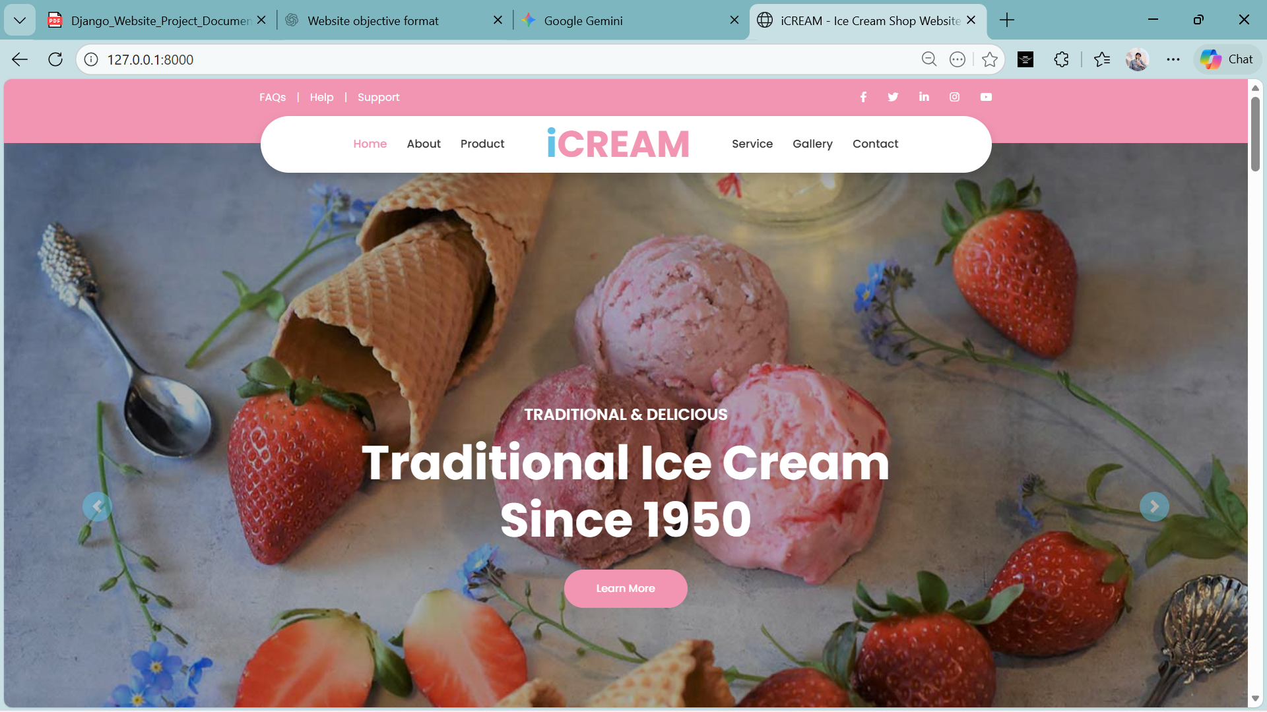
A.Homepage
Displays: Latest ice cream products, chefs, services, and 3 recent blog posts
Interactivity: Signup form (Name, Email, Favorite Flavor, Password)
Logic: Validates form, saves data to Signup model, sends user confirmation (HTML) and admin notification (plain text) emails

Slide 12
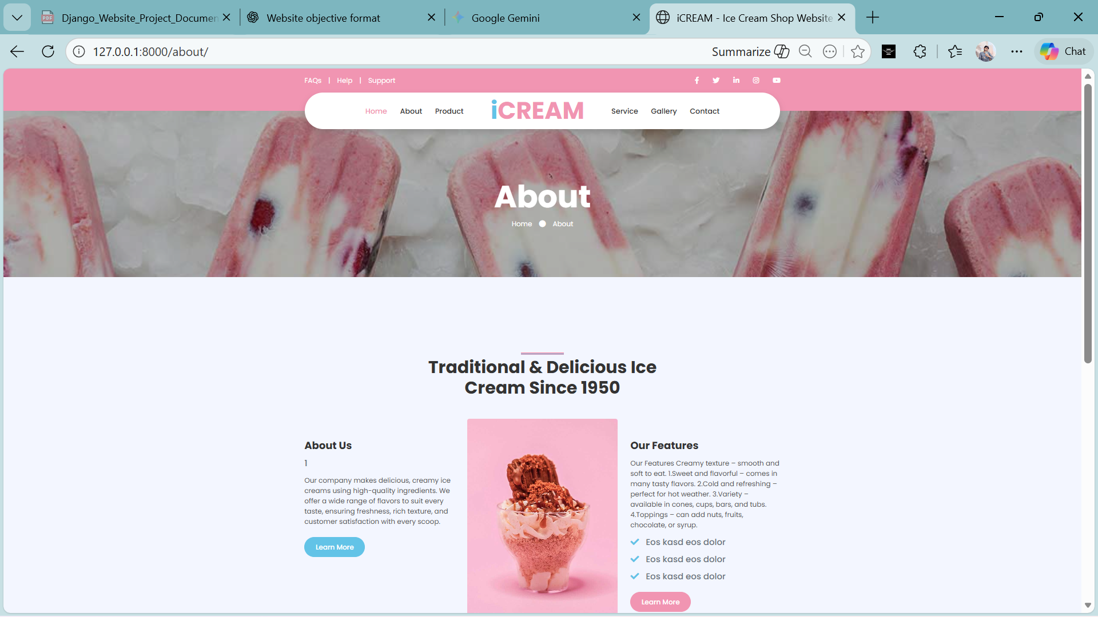
B. About Page
View: about_page
Displays: Company intro, ice cream quality & history, features, static content
Interactivity: None
Logic: Static page, only renders the template

Slide 13
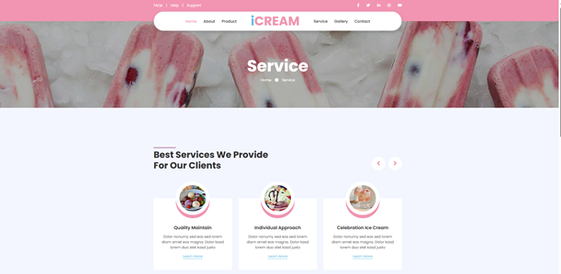
C. Service Page
View: service_page
Displays: Services (Quality Maintain, Individual Approach, Celebration Ice Cream) with images & descriptions
Interactivity: None
Logic: Services fetched from database, ordered by upload date, and rendered on UI

Slide 14
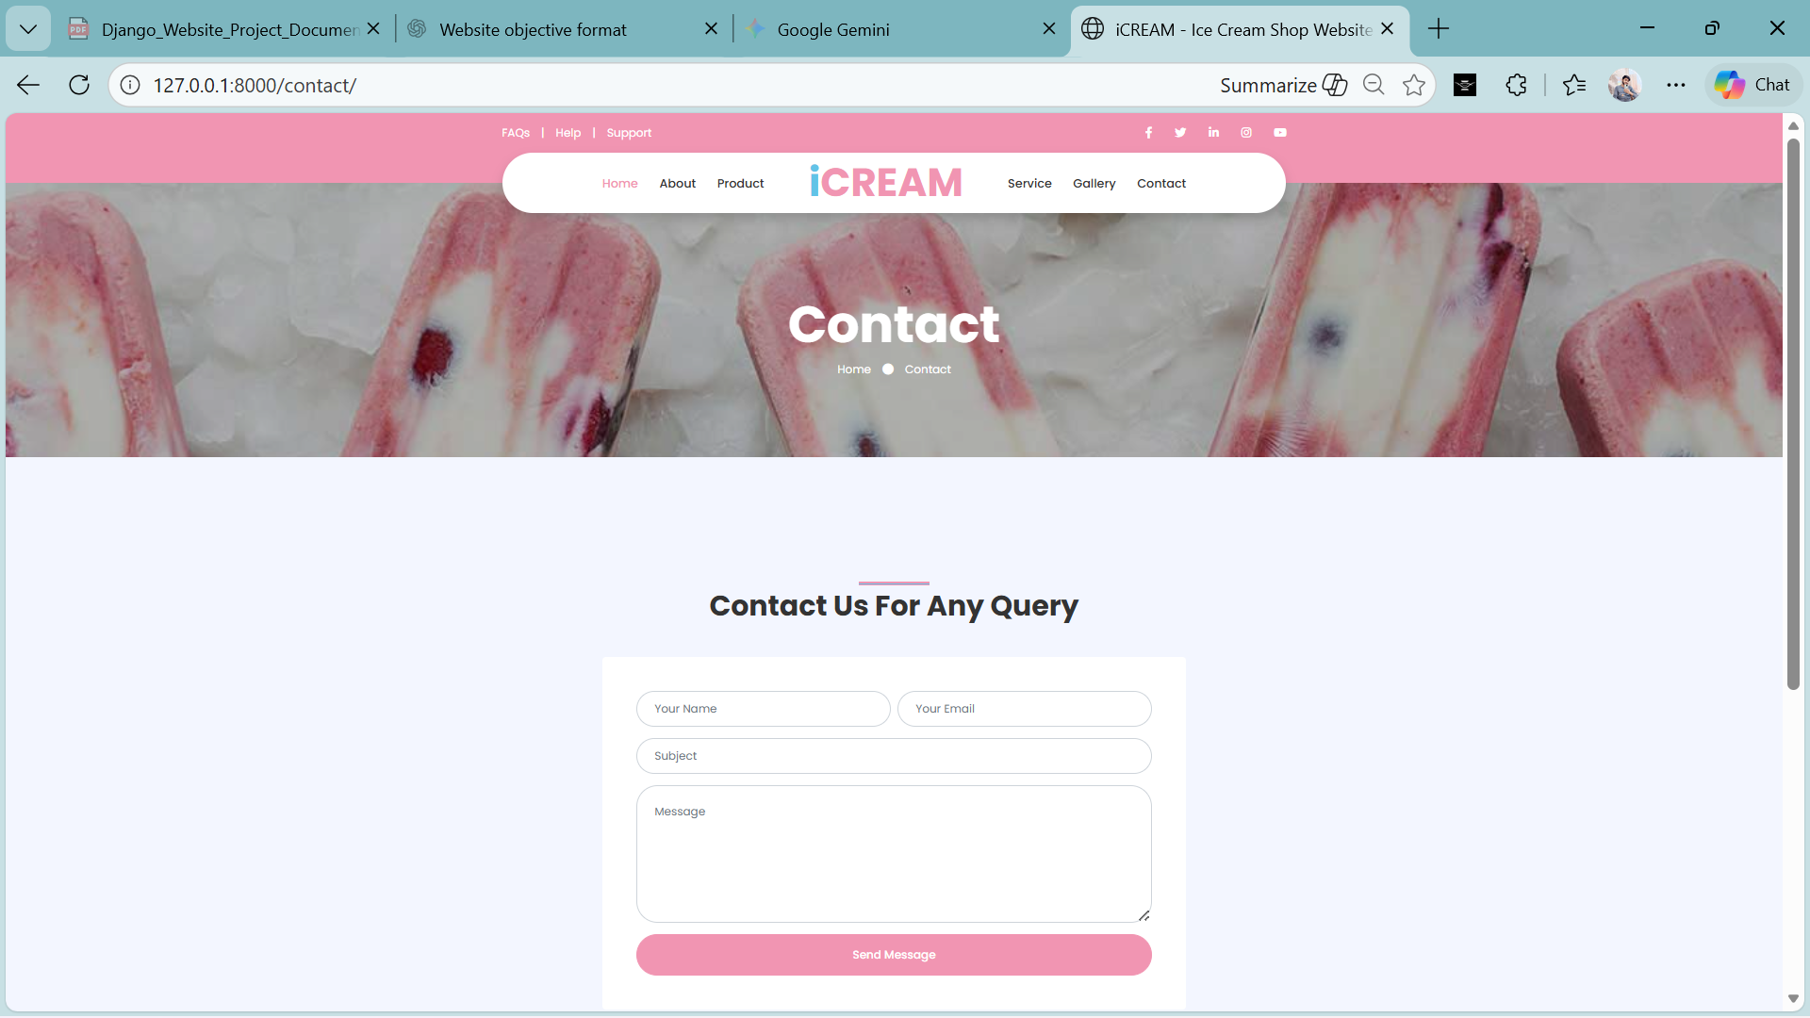
D. Contact page
View: contact_page
Displays: Contact form
Logic: Form validation, data saved to Contact model, optional admin email

Slide 15
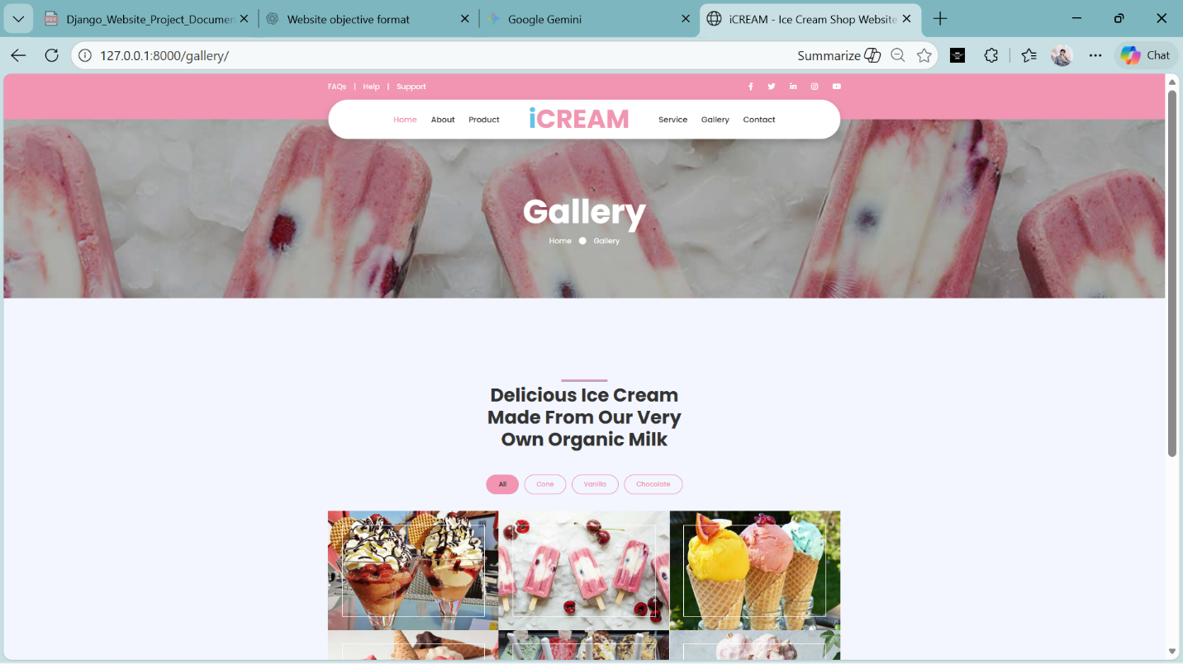
E. Gallery Page
View: gallery_page
Displays: Ice cream gallery with categories
Logic: Images fetched from Gallery model, frontend filter only

Slide 16
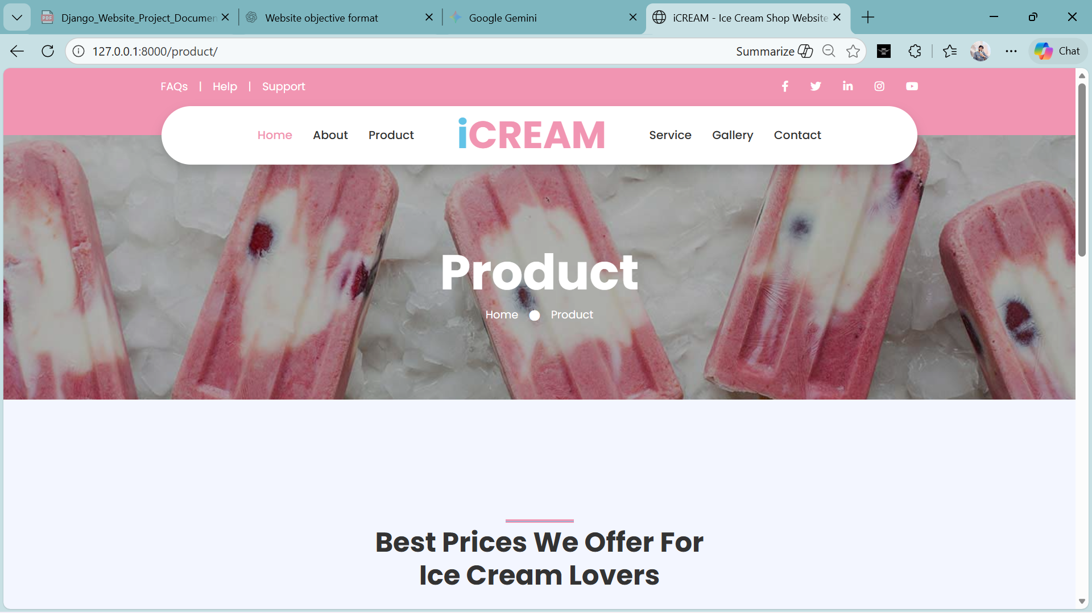
F. Product Page
View: product_page
Displays: All ice cream products
Logic: Products fetched from Product model, latest first

Slide 17
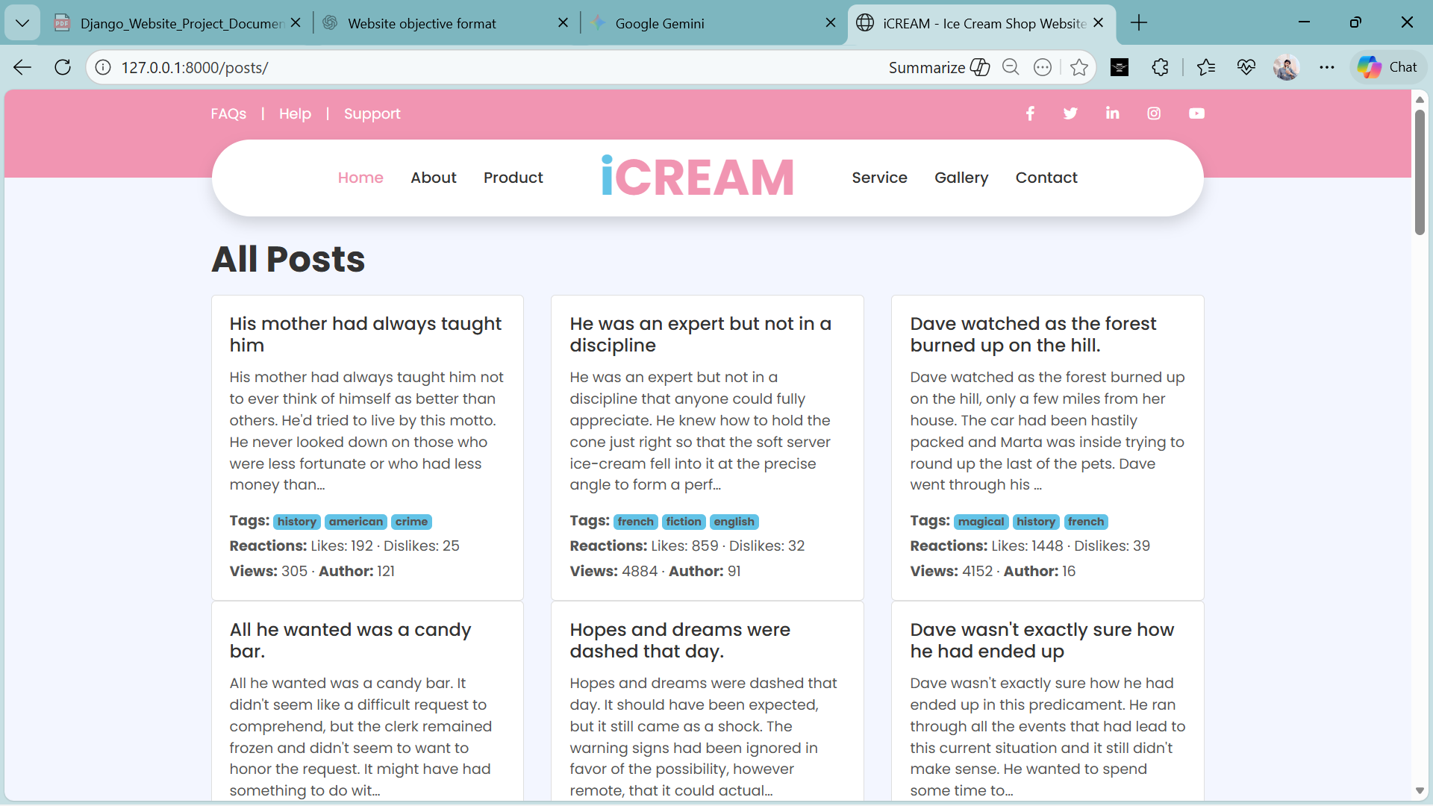
G.Third Party API
View: posts_page
Displays: Blog posts in card/grid format
Logic: Data fetched dynamically and rendered

Slide 18
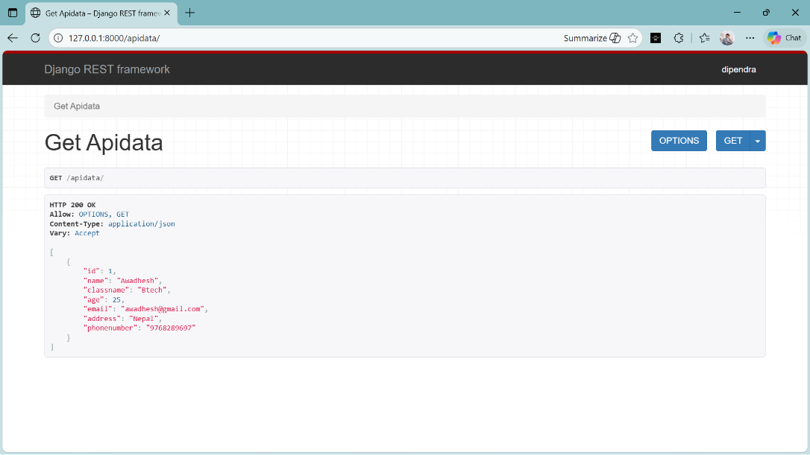
I. API (ApiData)
API Method: GET
Response Type: JSON
Displays: Blog posts data (title, description, tags, likes, views, author, etc.)
Logic: Data fetched dynamically from database via API and rendered in card/grid format

Slide 19
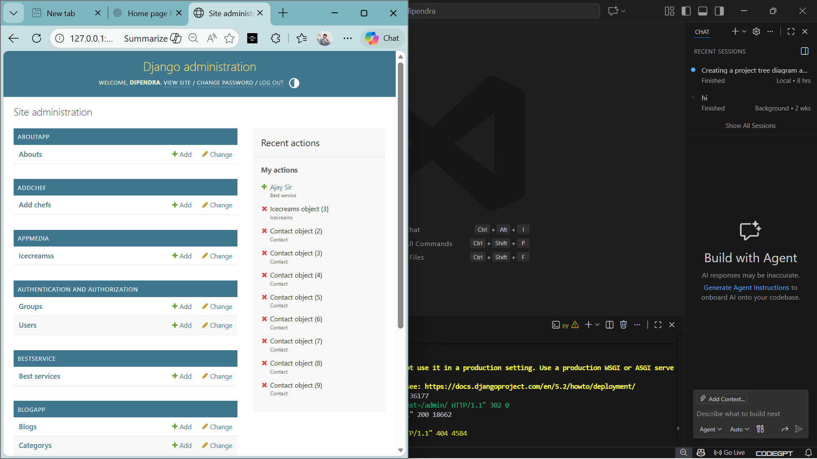
Admin Panel

Slide 20
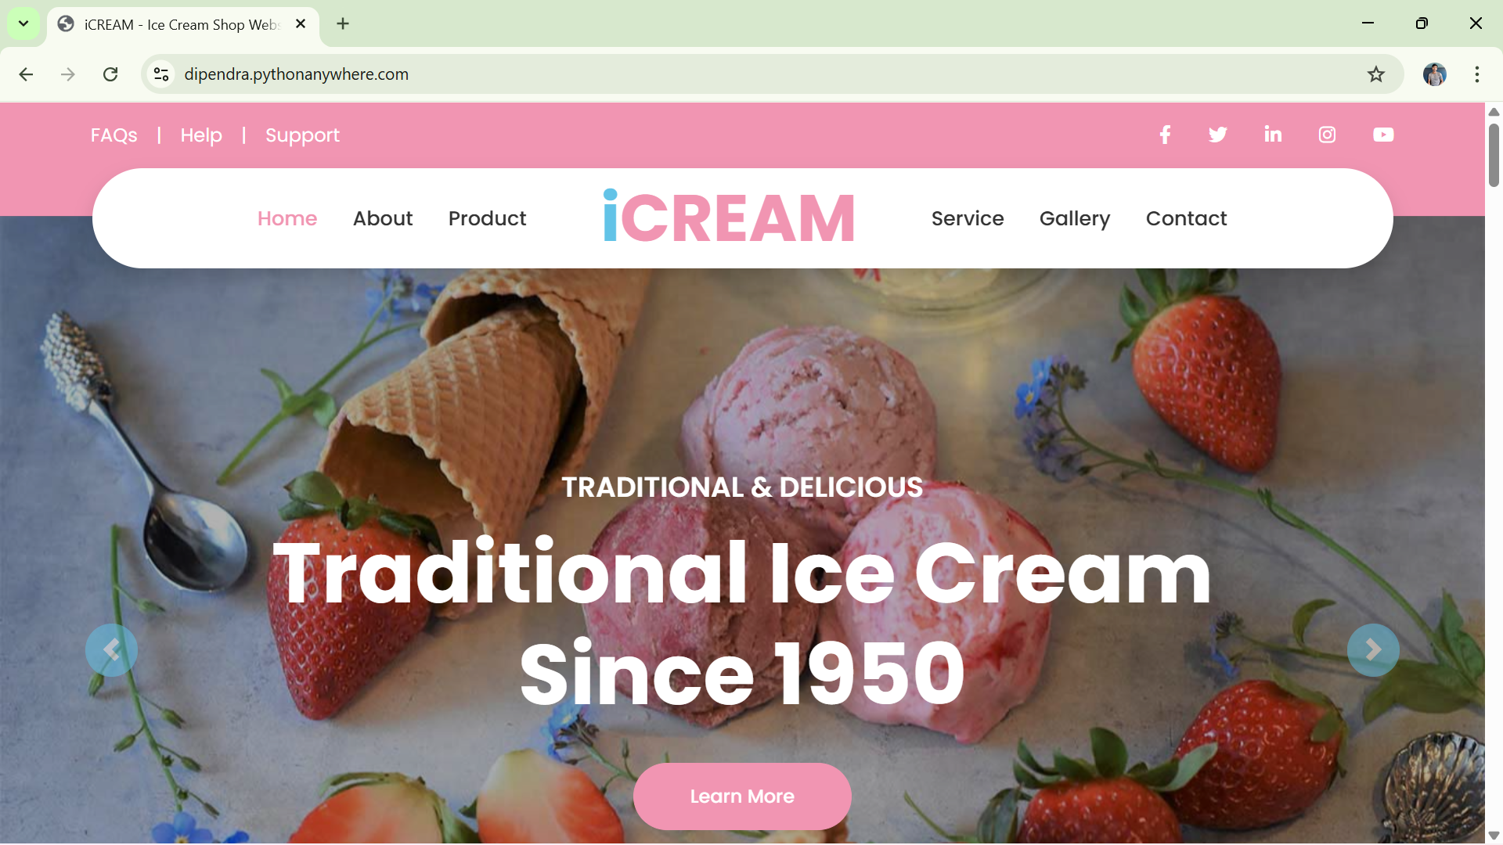
Hosted Website

Slide 21
Project Over View
• Dynamic content management
• Working contact form with email
• REST API functionality
• Third-party API integration
• Customized admin panel
• Live deployment

Slide 22
Future Inhancement
• User authentication and login
• CRUD functionality
• Payment gateway integration
• AJAX/React based UI
• Search and filter features

Slide 23
Conclusion
This project demonstrates a complete Django-based web application with backend integration, APIs, email services, and live hosting. It provides hands-on experience in full-stack web development using Django.

